Slide 1
Parking Management System
DataBase Project

Slide 2
Developed By
Muhammad Noor-ul-Hassan
Roll No : F21BSEEN1E02009

Slide 3
Parking Management System
The parking management system project is a digital solution that aims to streamline and optimize the management of parking spaces in various locations, such as shopping malls, airports, universities, and office buildings.
By implementing a parking management system, businesses and organizations can improve customer satisfaction, reduce traffic congestion, and increase revenue.

Slide 4
Functions used in project
cx-oracle [a module used for accessing oracle database]
conn.cursor [function that creates cursor object to execute sql statements]
cur.execute [to execute query and store data in cursor object]
conn.commit [a function that commits the changes made to databse]
cur.fetchone() [fetch single record/one row at a time]
cur.fetchall() [fetches all rows of a query result]

Slide 5
Create Database User
open oracle database
go to administrator
go to database user
create user

Slide 6
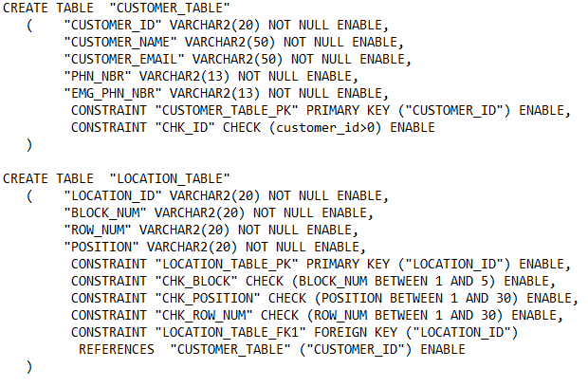
CREATE TABLES
CUSTOMER TABLE
LOCATION TABLE

Slide 7
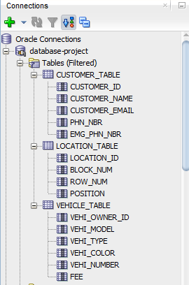
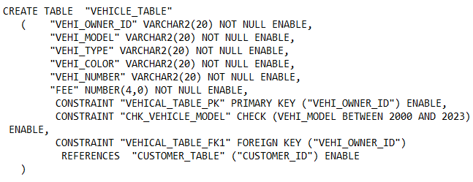
CREATE TABLES
VEHICLE TABLE

Slide 8
ENTITY RELATION DIAGRAM
ONE (AND ONLY ONE RELATIONSHIP BETWEEN TABLES)

Slide 9
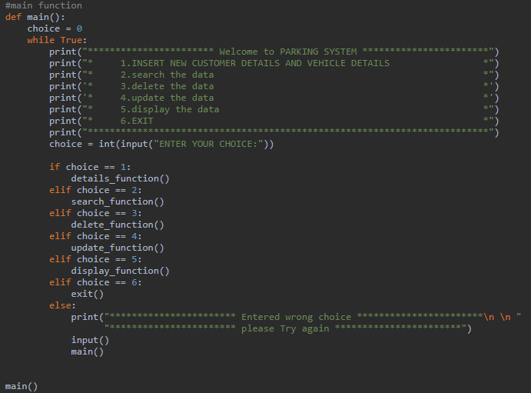
MAIN FUNCTION
Insert customer details,vehicle details and location details
search specific client data
delete specific client data
update specific client data
display specific client data

Slide 10
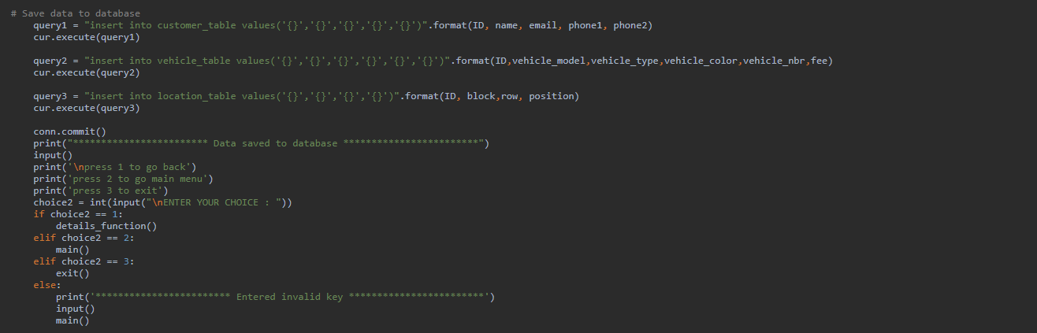
Insert function with database query
query1 insert customer details in customer table
query2 insert vehicle details in vehicle table
query3 insert vehicle location details in location table

Slide 11
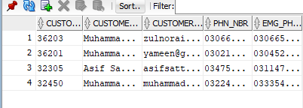
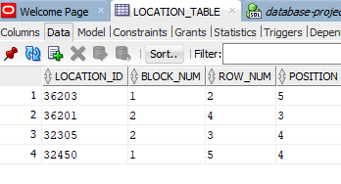
Insert function Output:

Slide 12
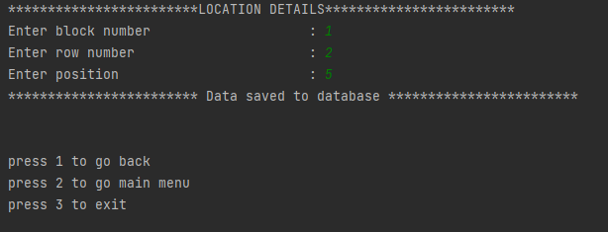
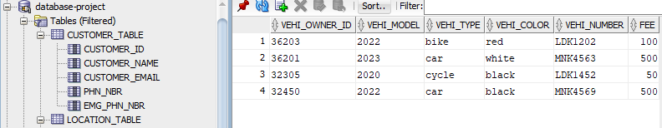
Insert function output:

Slide 13
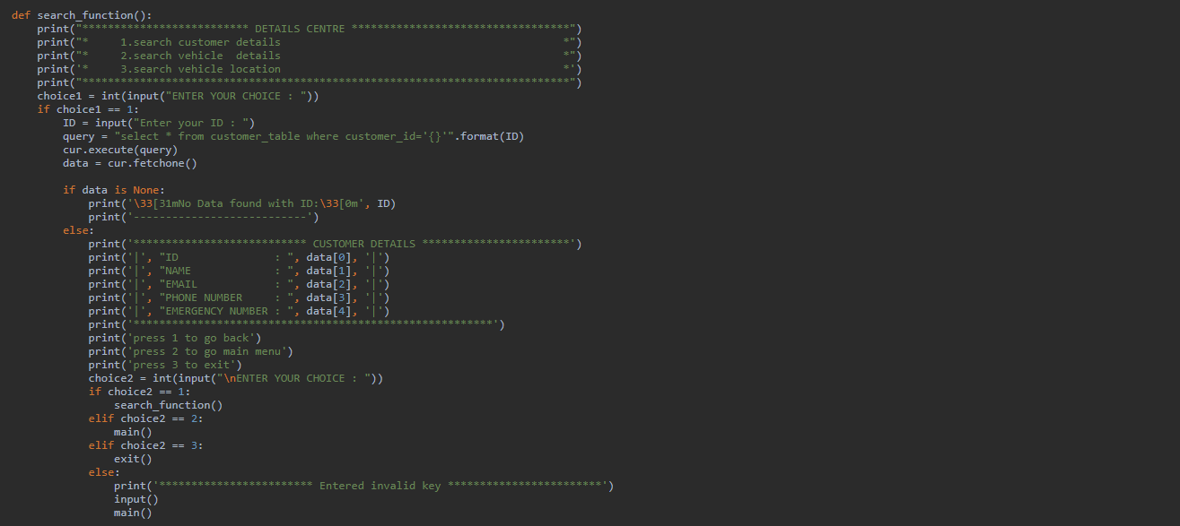
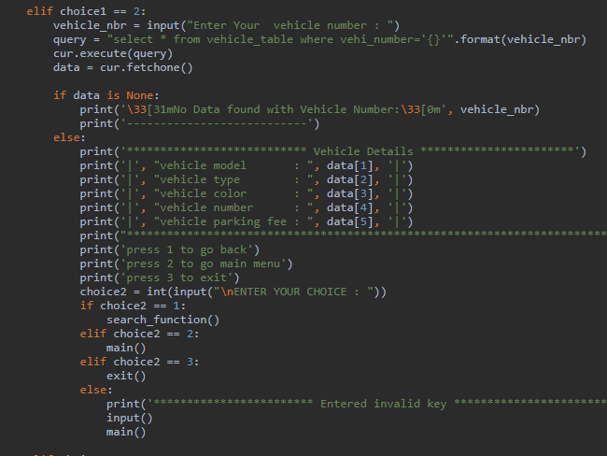
Search Customer & Vehicle details

Slide 14
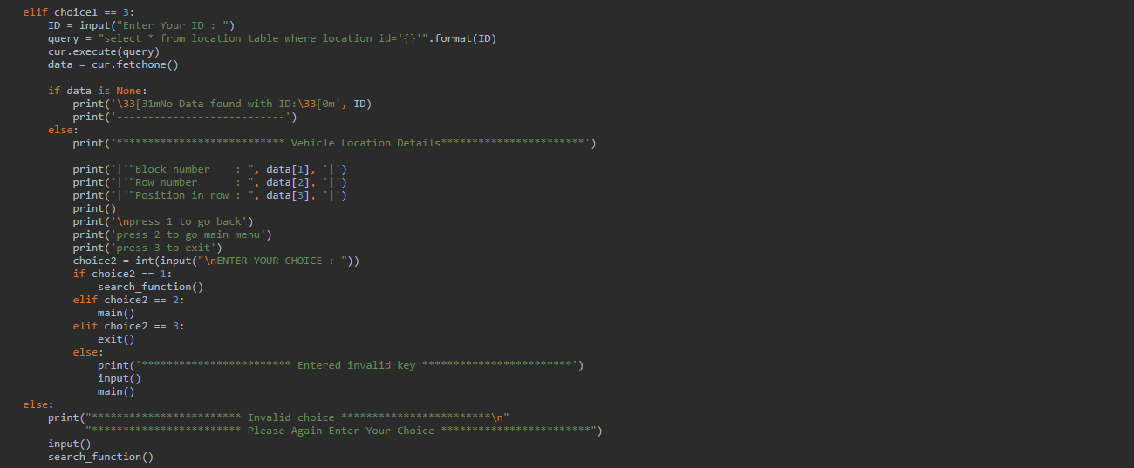
Search Vehicle location

Slide 15
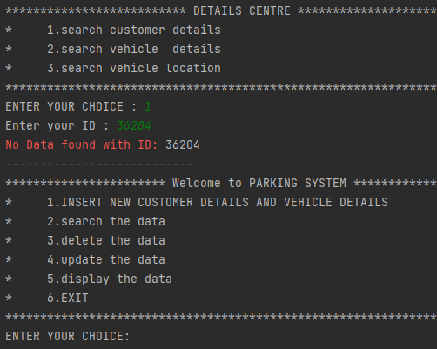
Search customer Details 1
Search vehicle details 2
Search location details 3

Slide 16
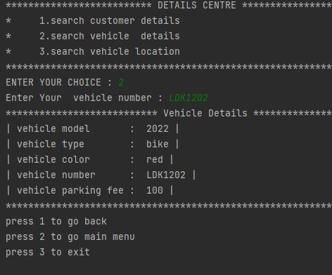
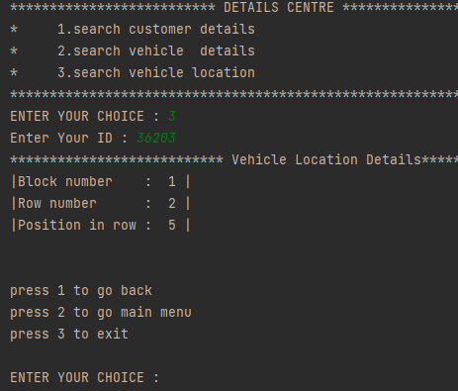
Search vehicle details Search Location Details

Slide 17
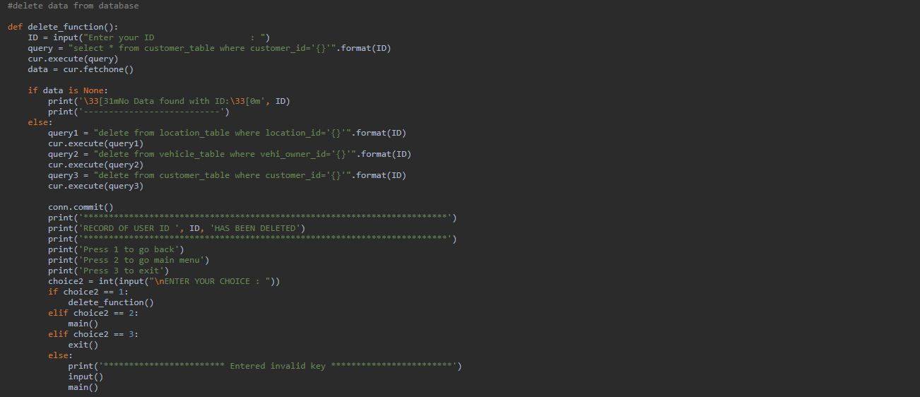
Delete Specific Customer Data

Slide 18
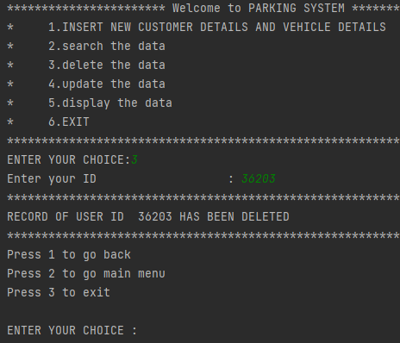
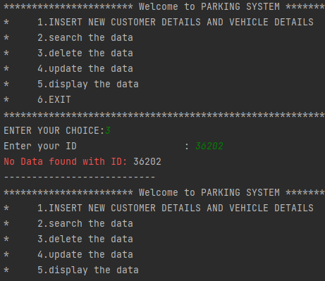
Delete User Data output

Slide 19
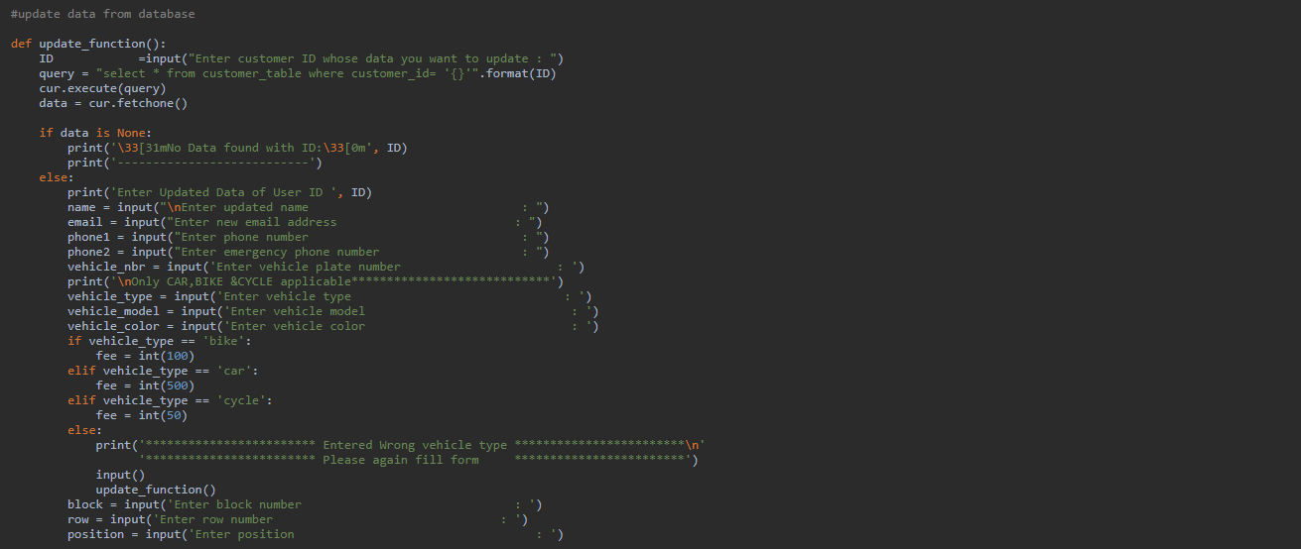
Update Data function

Slide 20
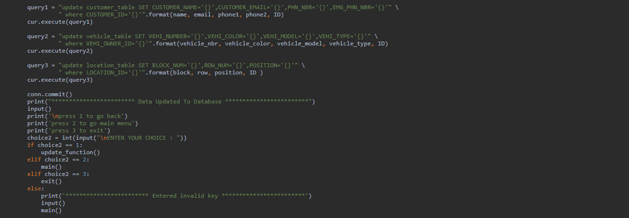
Update Data function
query1 update data in customer table
query2 update data in vehicle table
query3 update data in location table

Slide 21
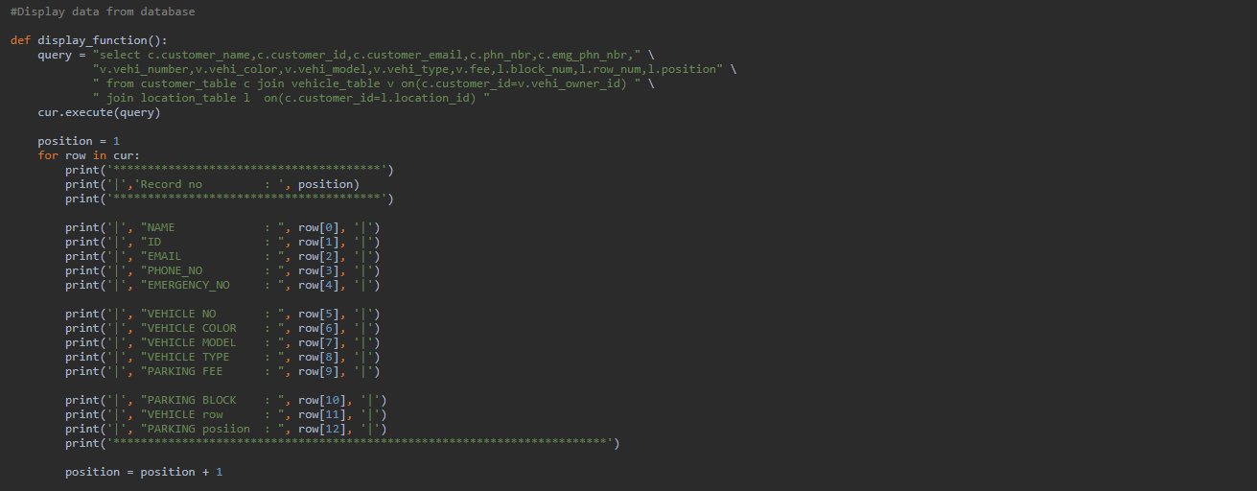
Display Data function
use inner join with On clause to join tables
use ID in on clause to display correct data

Slide 22
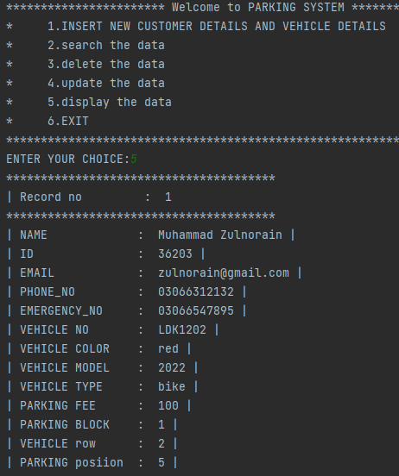
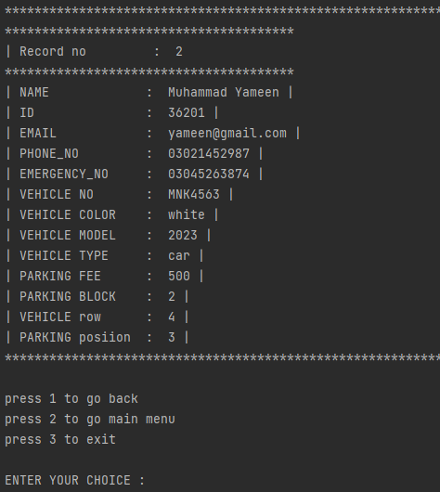

Slide 23
THANK YOU

